Slide 1

Superstore US Sales Analysis
By David Benitoe

Slide 2
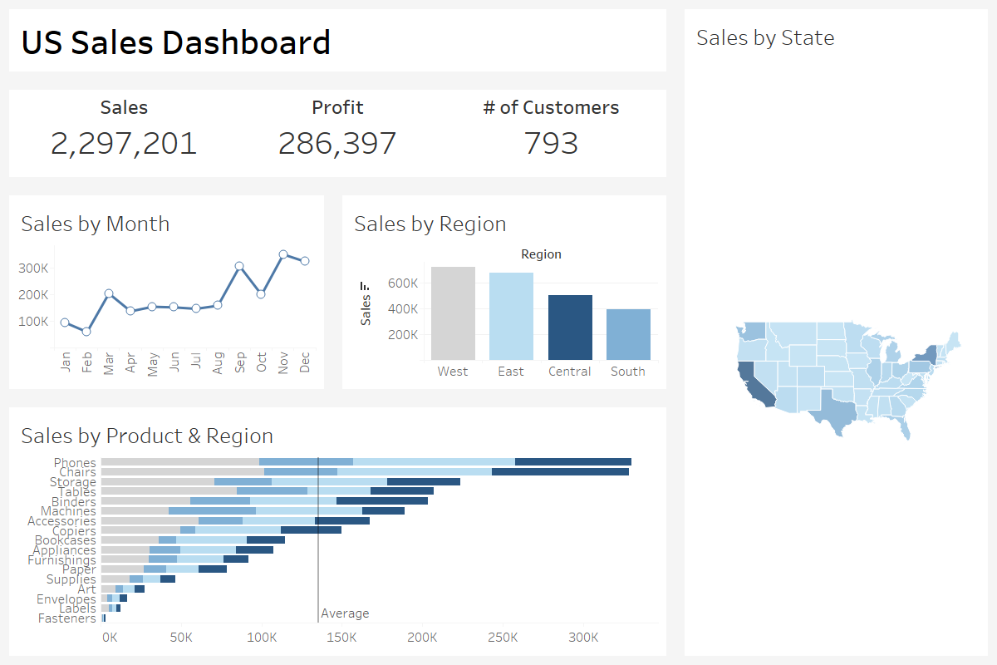

Slide 3

Overview
When reviewing the data for sales the year there are few things that stand out.
We see a steady increase of sales each month with peak sales in November. From April to August the sales we relatively consistent.
The West region performed the best sales wise totaling 725,458 sales
Phones and chairs had the highest sales, while fasteners has the lowest sales

Slide 4
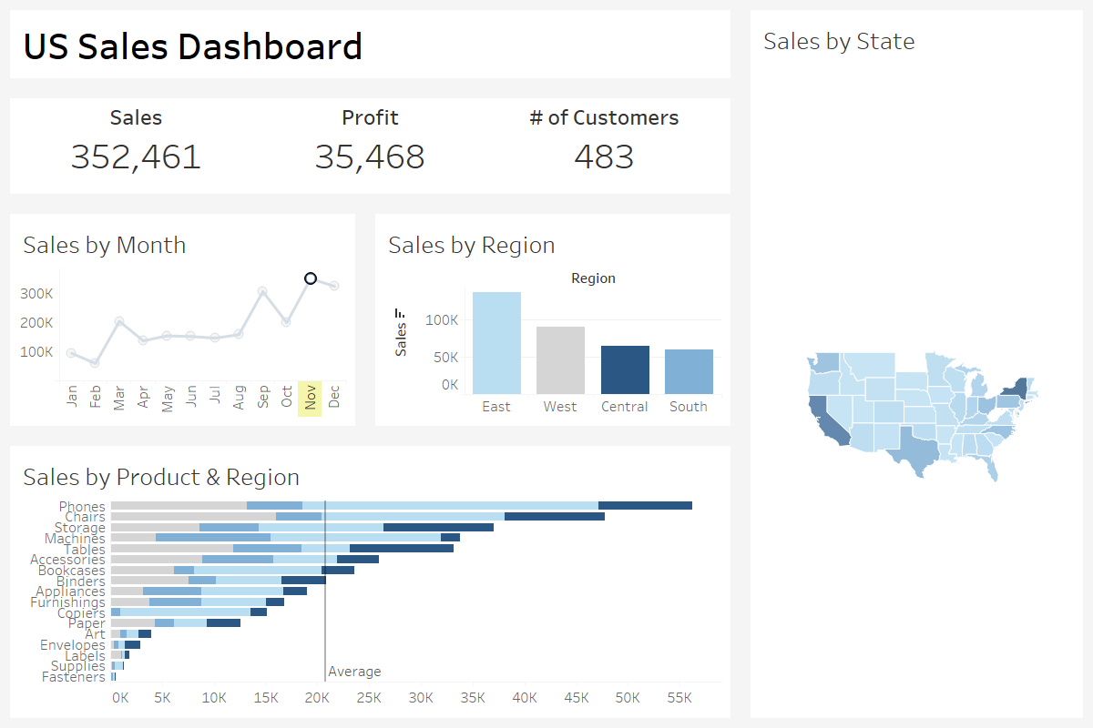
November Sales
We can clearly see that the number of sales peaked in November with phones being sold the most.
This makes sense the month of November is the beginning of the holiday season and black Friday and Cyber Monday heavily contribute to the high sales.
This could also be the reason why we see a slight decrease in sales in December. However, the decrease is nothing to be worried about.

Slide 5
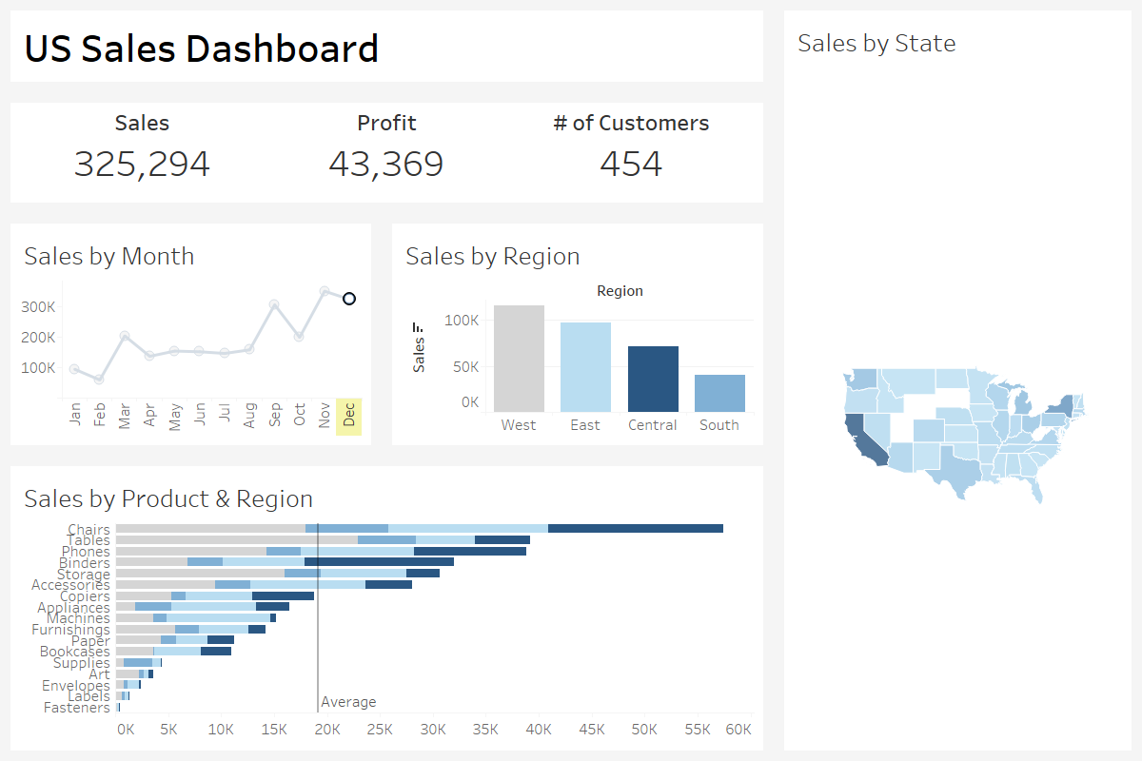
December Sales
As you can see the profit for the month of December is substantial. The reason I say this is because even though we see a decrease of sales by over 25K, our profit increased over 8K!

Slide 6
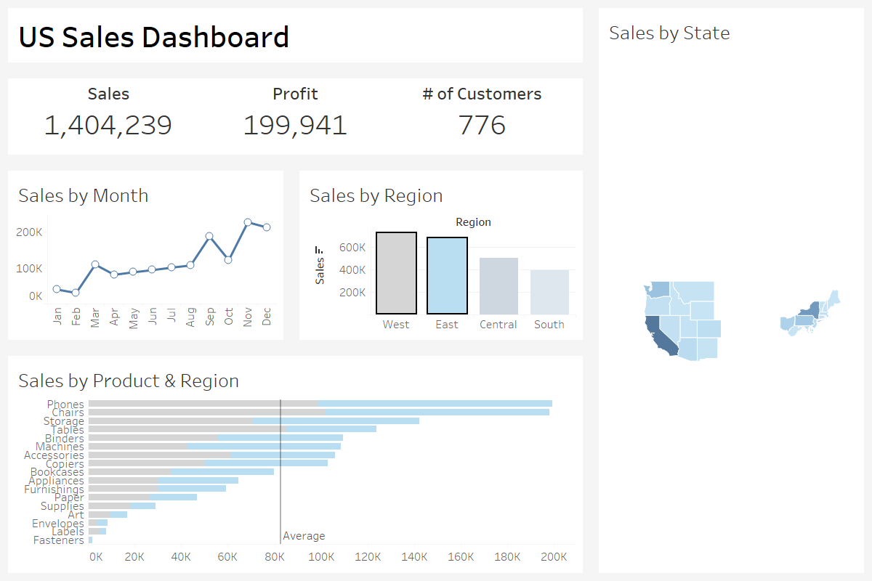
Sales in the East and West
Sales in the West and East far outpaced the Central and South regions.
This is to be expected as the majority as the states with the largest metropolitan areas, California and New York are in this region.
On surprise is that the sales of our chairs are relatively close to phone sales. This is surprising to me due the how the cell phone has become a part of pop culture but high sales in chairs is not a bad thing!

Slide 7
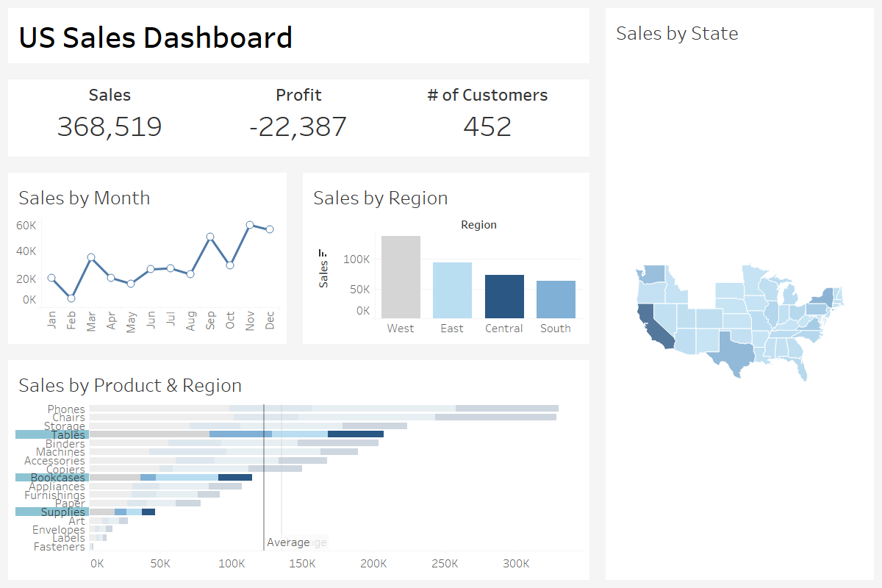
Products to Discontinue
These item: tables, bookcases, and supplies are lowering our profit. I recommend discontinuing them or increasing the price. Though I am open to any suggestions.

Slide 8

Questions?

Slide 9

End

